Slide 1
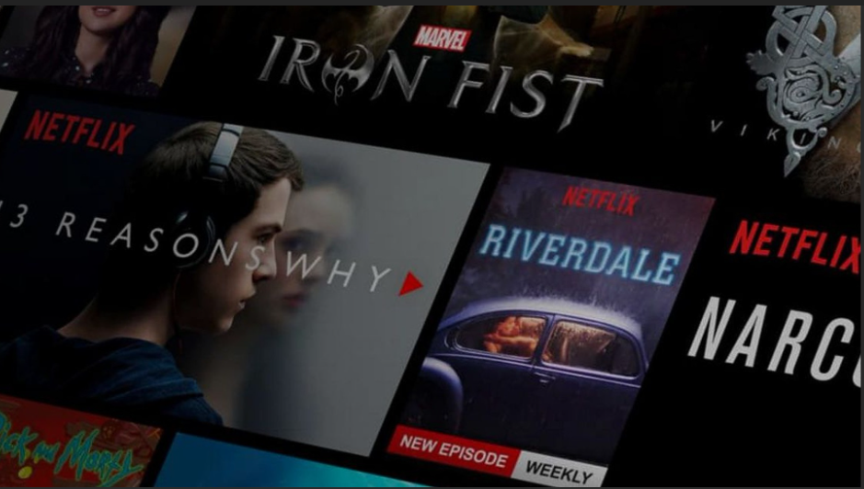
Movie Recommendation System
By Pursharth Singh Doaj
199301014

Slide 2
What is a movie recommendation system?
A movie recommendation system is a type of software that suggests movies to users based on their preferences, viewing history, and other factors. The goal of such a system is to provide personalized recommendations to each user, helping them discover movies that they may enjoy but have not yet seen.
These systems use various algorithms and data analysis techniques to determine which movies are likely to be a good match for a particular user. Some systems rely on collaborative filtering, which looks at the viewing history of similar users to make recommendations, while others use content-based filtering, which analyzes the content of the movies themselves to suggest similar films. They can also use hybrid filtering, which combines both content and collaborative based filtering to provide recommendations.

Slide 3
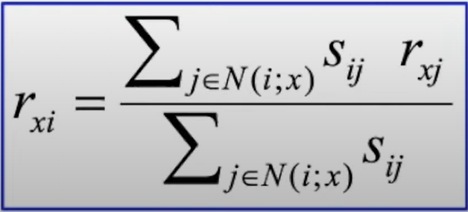
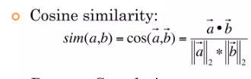
Methodology
We will be using item-item collaborative filtering with nearest neighbour and cosine similarity to implement our movie recommendation system.
We are using this approach since it is both fast and accurate, both qualities that are greatly suited for a lightweight web application.
We will make use of ratings which the user has previously given to movies to predict the rating of the movies which the user has not seen. The predicted rating of a movie ‘x’ will be calculated using the most similar ‘n’ movies which the user has seen which are similar to movie ‘x’
This similarity between the two movies will be calculated using cosine similarity

Slide 4
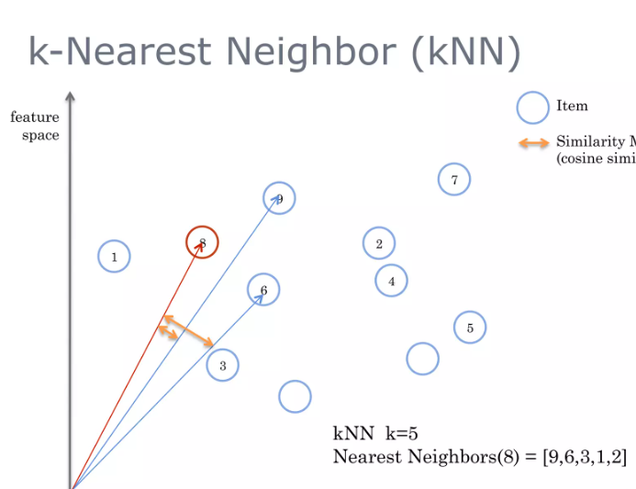
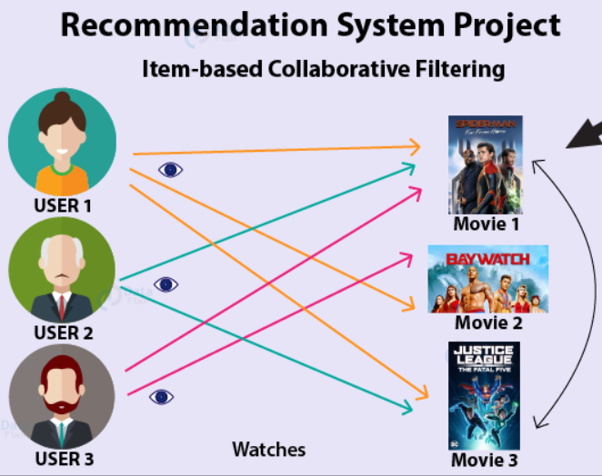
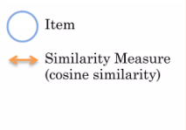
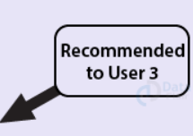
Item-Item collaborative filtering and nearest neighbour illustration

Slide 5
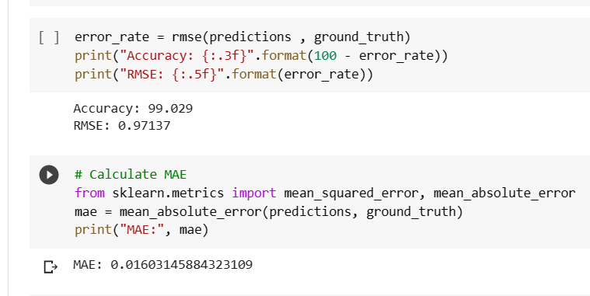
Accuracy/Error rate (on training data)
We will use RMSE (Root Mean Square Error) and MAE (Mean absolute error) to calculate the accuracy of our recommendation system

Slide 6
Web Application implementation
For our dataset, we will be using the MovieLens dataset, which is a popular dataset for user-movie ratings.
. We will be using Numpy, Pandas, Scikit-Learn libraries in Python to implement our model.
For our frontend, we will be using HTML/CSS along with Javascript/ ReactJs.
For our database, we will either be using an SQL database framework like MySQL/PostgreSQL or NoSQL database like MongoDB
Our backend will be implemented by either Flask or NodeJs with Express

Slide 7
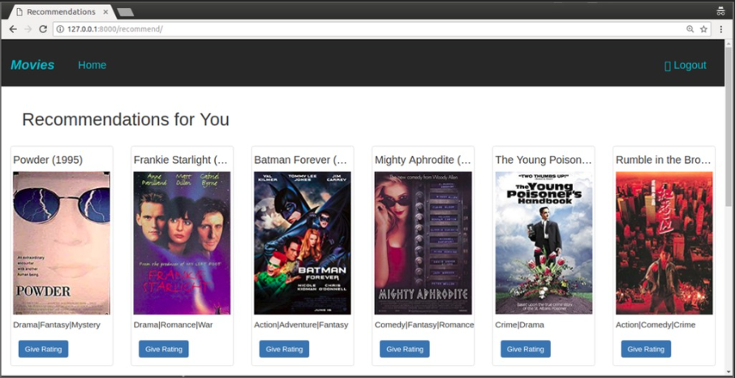
How the web application will look like (for reference)

Slide 8
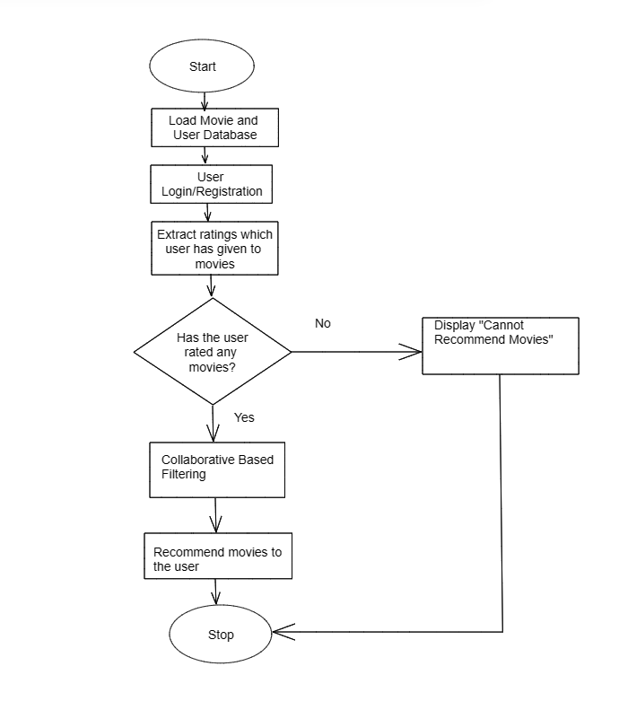
Flowchart of our application
Flowchart can be summarised as follows:
Login/Register User
Extract ratings from the user if they haven’t rated any movies/want to rate movies
Provide recommendations based on the ratings provided by the user using item-item collaborative based filtering

Slide 9
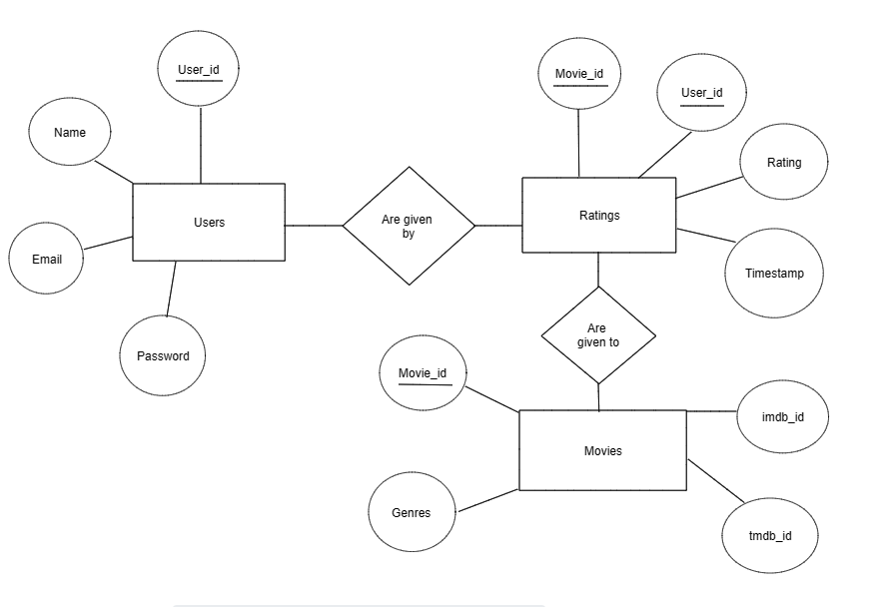
Entity Relationship Diagram (Database)

Slide 10
Future Scope
Incorporating more complex algorithms: While nearest neighbour and cosine similarity are effective algorithms for recommendation systems, there are more complex algorithms that could improve the system's accuracy and performance, such as deep learning algorithms.
Incorporating user feedback: The system can be enhanced by incorporating user feedback into the recommendation process. This can involve collecting explicit feedback, such as ratings and reviews, as well as implicit feedback, such as user behaviour data.
Personalizing recommendations: The system can be further personalized by taking into account each user's unique preferences, viewing history, and demographics. This can involve using machine learning algorithms to create user profiles and tailor recommendations to their preferences.
Implementing real-time updates: The system can be improved by implementing real-time updates to ensure that it has access to the latest information on new movies and user preferences.

